Slide 1

AI Workshop
By Muhamad Nur Rohman
Day 1
July 5, 2022

Slide 2
Topics
1. Dataset pre-processing | : | Normalization (input and output) | Day 1
 |  | Randomization (shuffle)
 |  | Dataset division (training, validation, and testing)
 |  | Dataset division using cross validation
2. Variable importance analysis | : | Random forest | Day 1
3. AI-based modeling | : | Support vector machine (SVM/SVR) | Day 2
 |  | Random forest for classification/regression
 |  | ANN/DNN
4. Metaheuristic optimization | : | Particle swarm optimization (PSO) | Day 3
5. Hybrid AI-based model – metaheuristic optimization (Hyperparameter tuning) | : | SVR-PSO ANN-PSO DNN-PSO ANN/DNN fine-tuning | Day 4
6. Optimization using machine learning model | : | PSO-SVR | Day 5
7. Object measurement | : | Computer vision / OpenCV | Day 6

Slide 3
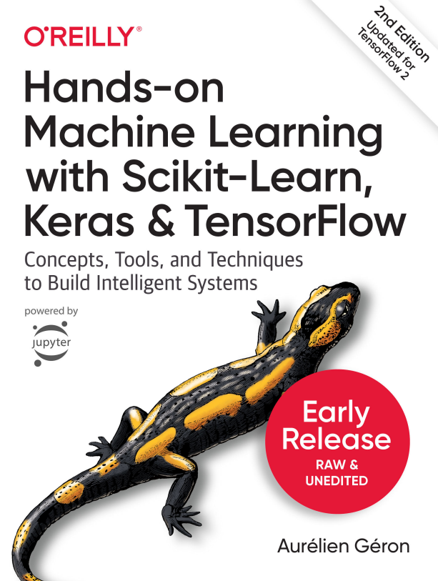
Recommended book

Slide 4
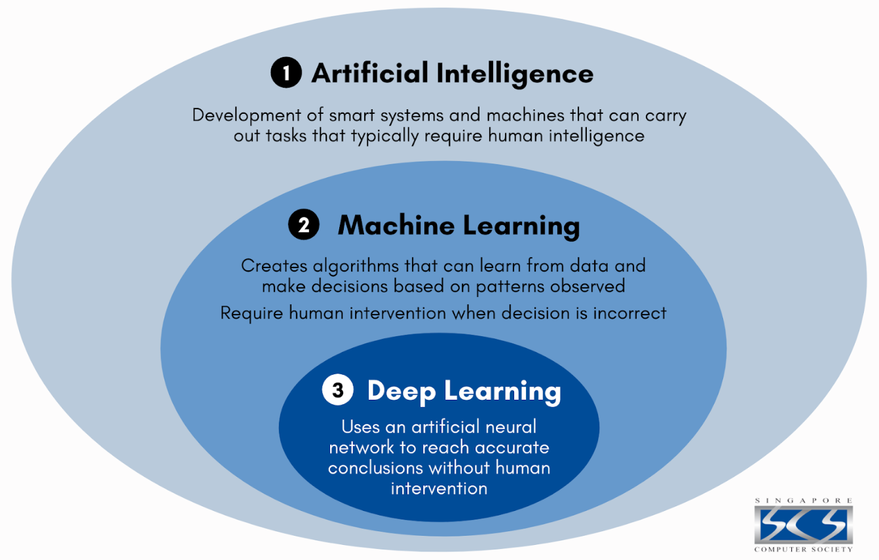
AI Vs. Machine learning Vs. Deep learning

Slide 5
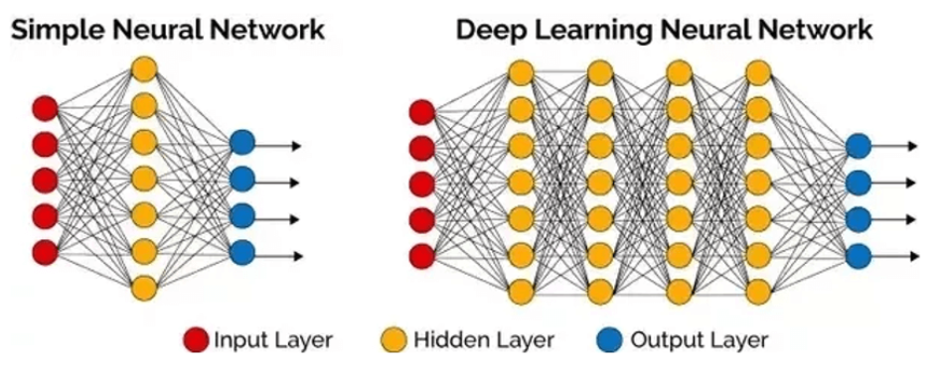
Machine learning Vs. Deep learning
Machine learning

Slide 6

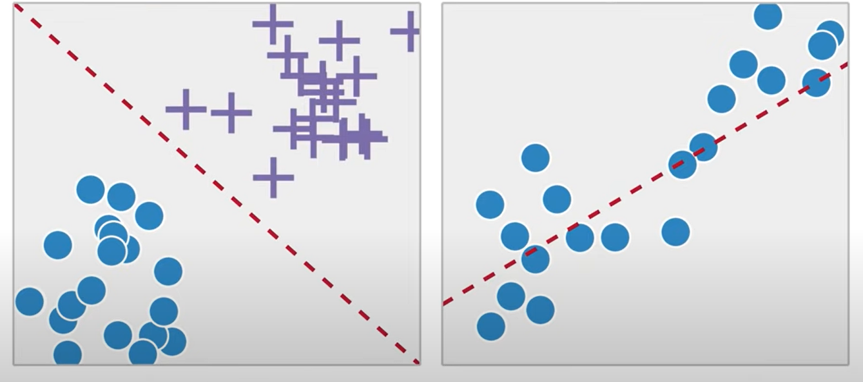
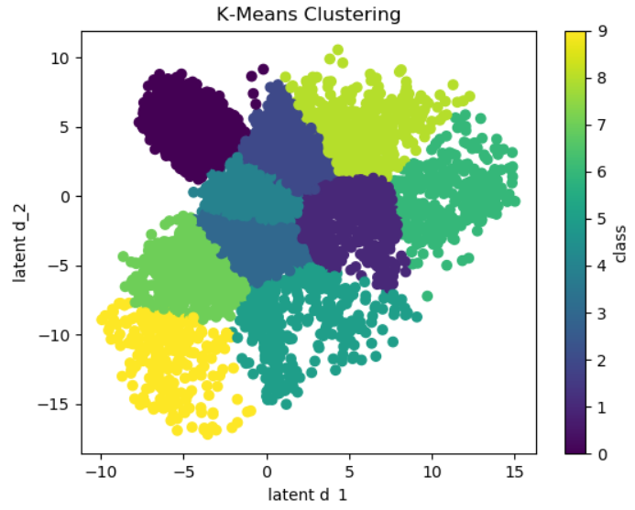
Machine learning algorithms
Classification
Regression
Classification
Regression
Clustering
Clustering
Classifying labeled data
Predicting trends using previous labeled data
Finding patterns and groupings from unlabeled data

Slide 7
Machine learning
Supervised learning.
Learning from labeled data.
Example: SVM, Logistic Regression, Decision Tree, Random Forest, Linear Regression, LSTM, and Neural Network.
Unsupervised learning.
Learning from patterns of unlabeled data.
Example: K-Means Clustering.

Slide 8
Modeling flowchart
Dataset collection
Dataset pre-processing
Dataset division
Choose the model
Hyperparameter setting
Training
Evaluation
Satisfy with the performance?
Save the model
Use the model
Hyperparameter tuning

Slide 9
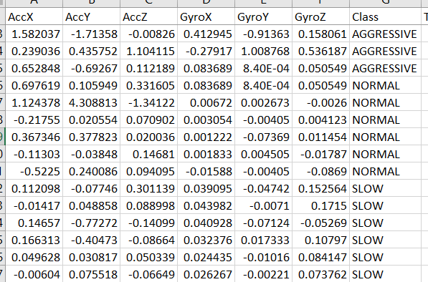
Dataset
Regression
Classification
Laser cutting experiment
Driving Behavior
Target / label
Input / feature
Target / label
Input / feature
Power (%) | Frequency (kHz) | Cutting Speed (mm/s) | Kerf width (um)
60 | 20 | 0.1 | 53.744
60 | 40 | 0.1 | 53.029
70 | 20 | 0.1 | 47.340
70 | 40 | 0.1 | 82.123
70 | 60 | 0.1 | 49.824
80 | 20 | 0.1 | 90.388
80 | 40 | 0.1 | 108.310
80 | 60 | 0.1 | 87.565
60 | 20 | 0.2 | 32.574
Continuous labeled data
Discrete labeled data

Slide 10
Dataset pre-processing
Feature normalization
Normalization is a scaling technique in Machine Learning applied during data preparation to change the values of numeric columns in the dataset to use a common scale.
It is not necessary for all datasets in a model. It is required only when features of machine learning models have different ranges.
Input/feature
Target
Power (%) | Frequency (kHz) | Cutting Speed (mm/s) | Kerf width (um)
60 | 20 | 0.1 | 53.744
60 | 40 | 0.1 | 53.029
70 | 20 | 0.1 | 47.340
70 | 40 | 0.1 | 82.123
70 | 60 | 0.1 | 49.824
80 | 20 | 0.1 | 90.388
80 | 40 | 0.1 | 108.310
80 | 60 | 0.1 | 87.565
60 | 20 | 0.2 | 32.574

Slide 11
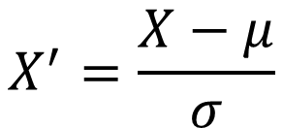
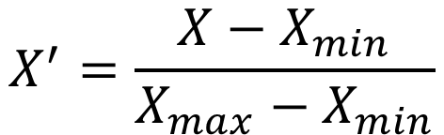
Dataset pre-processing
Feature normalization technique
Min-max scaling
> Scaling 0-1
Standardization scaling
> Z-score normalization
$$X^{′}=\frac{X−X_{min}}{X_{max}−X_{min}}$$
$$X^{′}=\frac{X−μ}{σ}$$

Slide 12
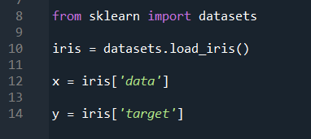
Dataset pre-processing
Exercise 1
Feature normalization
Python implementation
Import dataset:

Slide 13
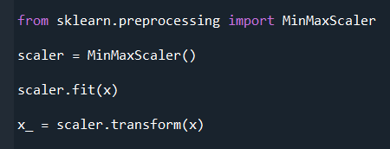
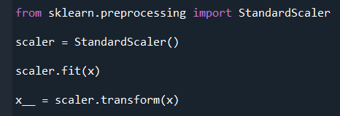
Dataset pre-processing
Exercise 2
Feature normalization
Python implementation
Min-max scaling:
Standardization scaling

Slide 14
Dataset pre-processing
Target normalization
If the input use a Min-max scaling in normalization, then the target also uses a Min-max scaling.
If the input use a Standardization scaling in normalization, then the target also uses a Standardization scaling.
Do not mix.

Slide 15
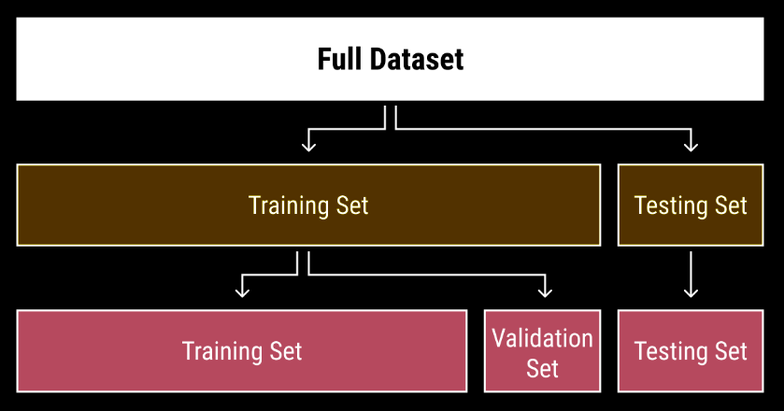
Dataset division

Slide 16
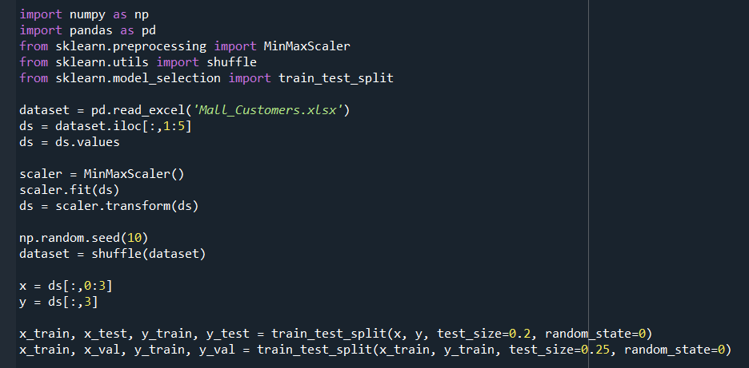
Dataset division
Python implementation
Exercise 3

Slide 17
n-Fold Cross Validation
Total number of dataset
Shuffle
 | Fold-1 | Fold-2 | Fold-3 | … | Fold-n
1st Model | Training | Training | Training | … | Validation
2nd Model | Training | Training | Validation | … | Training
3rd Model | Training | Validation | Training | … | Training
….. | … | … | … | … | …
n^{th} Model | Validation | Training | Training | … | Training
Fold-n+1
Testing
Testing
Testing
…
Testing

Slide 18
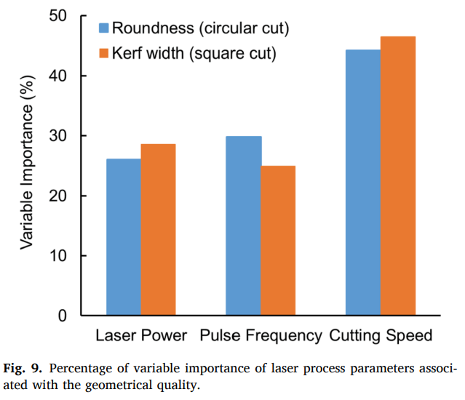
Variable importance analysis
To study the level of influence of process parameters associated with output variable

Slide 19
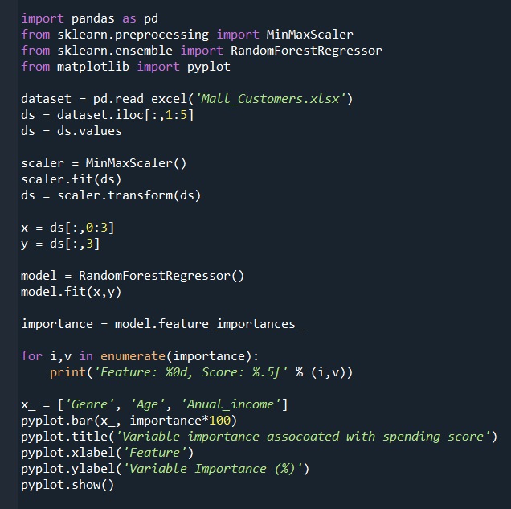
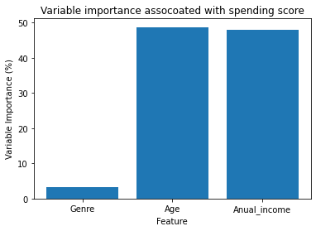
Variable importance analysis
Python implementation
Exercise 4

Slide 20
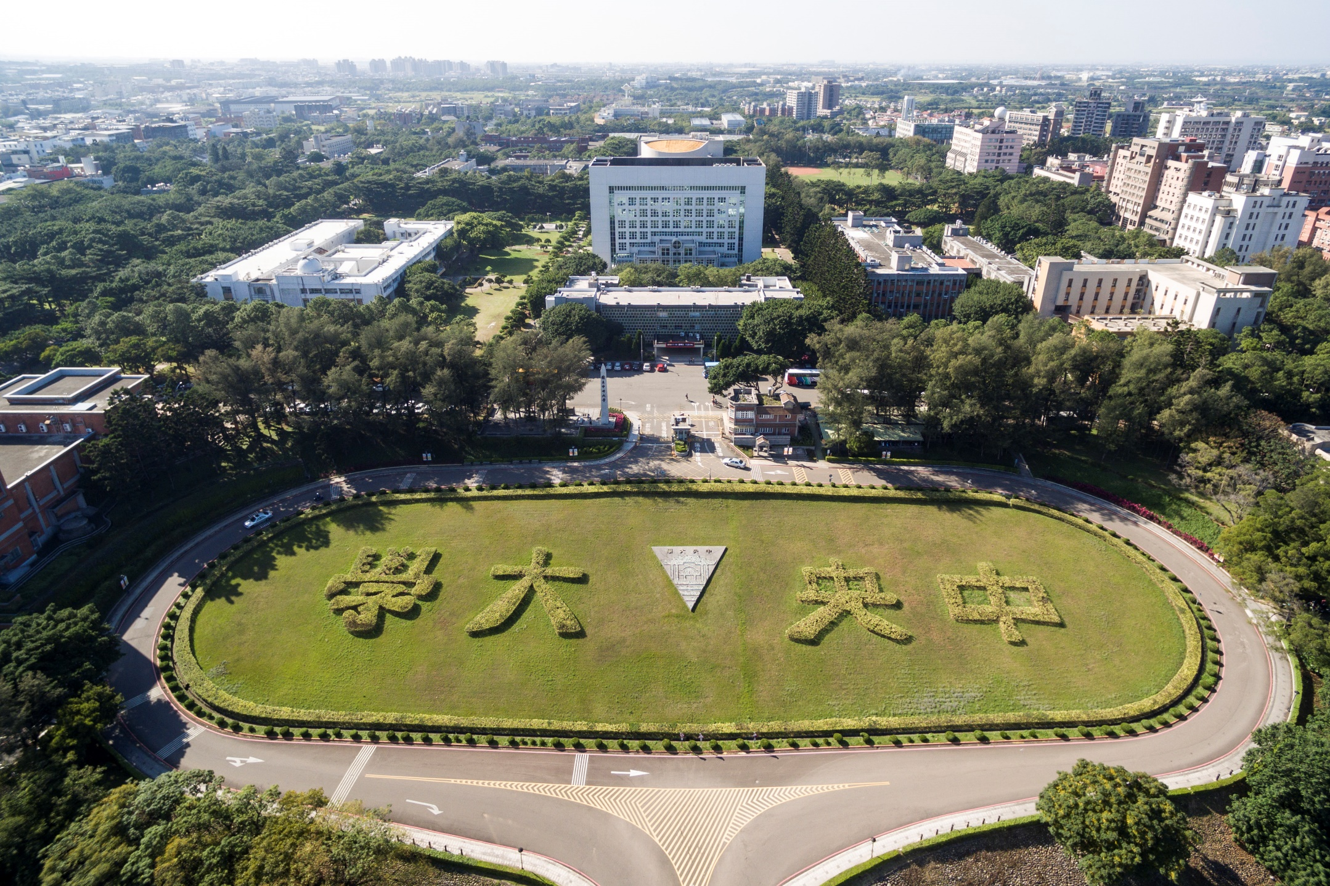
Thank you for your attention

